Slide 1
The Application of deep learning techniques towards particle identification and high energy physics event simulations
CG Viljoen – MSc Data Science
16 August 2019

Slide 2
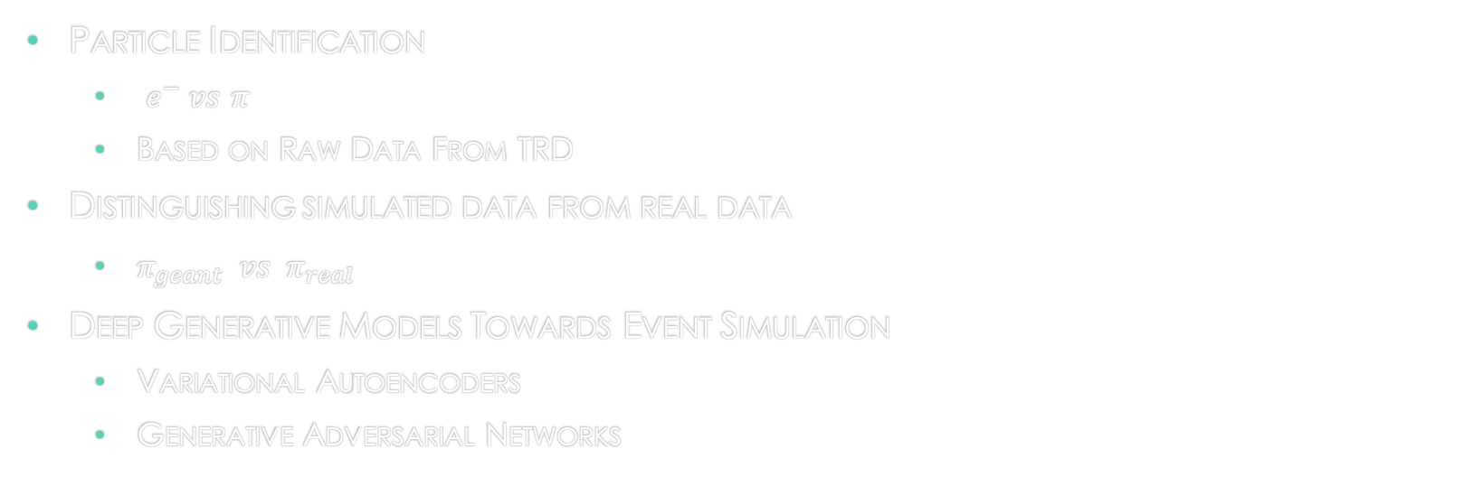
Aims
Particle Identification
$e^{−} vs$ $π$
Based on Raw Data From TRD
Distinguishing simulated data from real data
$π_{geant} vs π_{real}$
Deep Generative Models Towards Event Simulation
Variational Autoencoders
Generative Adversarial Networks

Slide 3
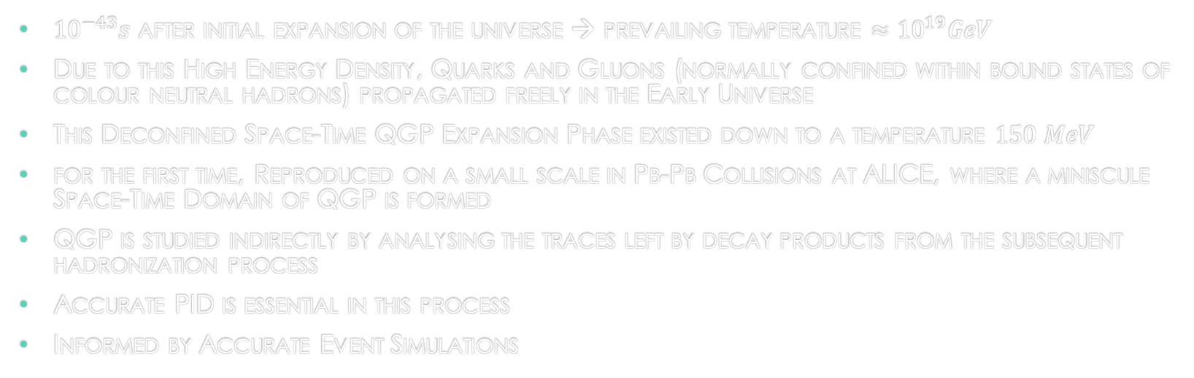
Motivation: Quark Gluon Plasma
${10}^{−43}s$ after initial expansion of the universe → prevailing temperature $≈{10}^{19}GeV$
Due to this High Energy Density, Quarks and Gluons (normally confined within bound states of colour neutral hadrons) propagated freely in the Early Universe
This Deconfined Space-Time QGP Expansion Phase existed down to a temperature $150 MeV$
for the first time, Reproduced on a small scale in Pb-Pb Collisions at ALICE, where a miniscule Space-Time Domain of QGP is formed
QGP is studied indirectly by analysing the traces left by decay products from the subsequent hadronization process
Accurate PID is essential in this process
Informed by Accurate Event Simulations

Slide 4

Presentation Outline
The ALICE Detector System & the TRD
Deep Learning
Latent Variable Models
Conclusions

Slide 5
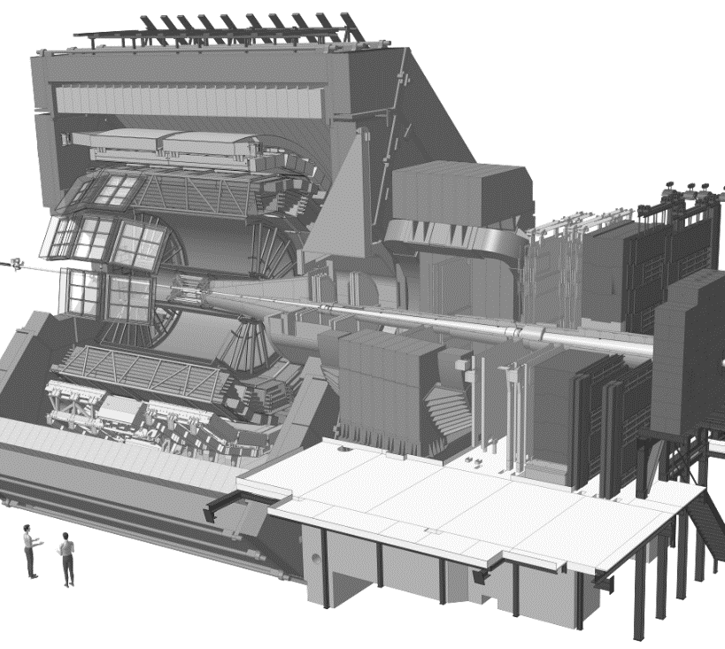
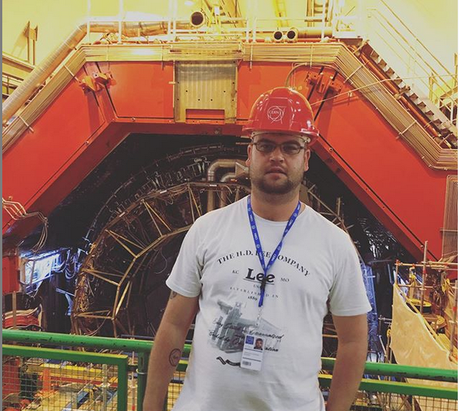
The ALICE Detector system
10 000 tonnes
26m x 16m x 16m
18 stacked subdetectors

Slide 6
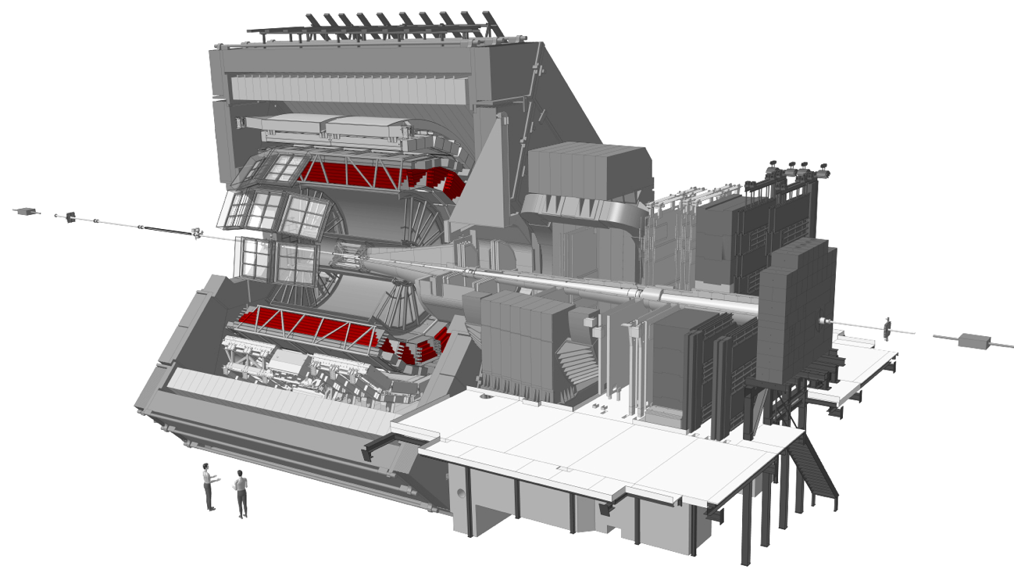
Transition radiation detector

Slide 7
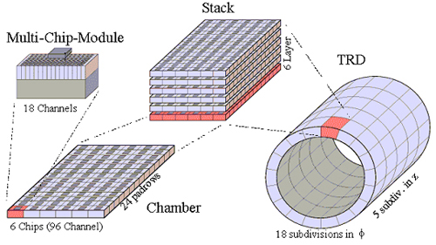

Slide 8
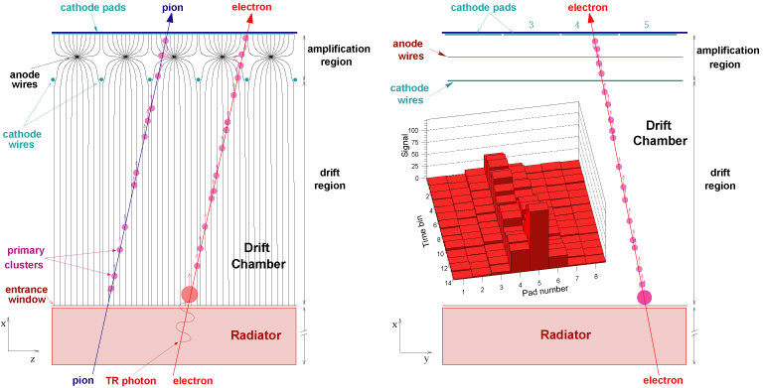

Slide 9
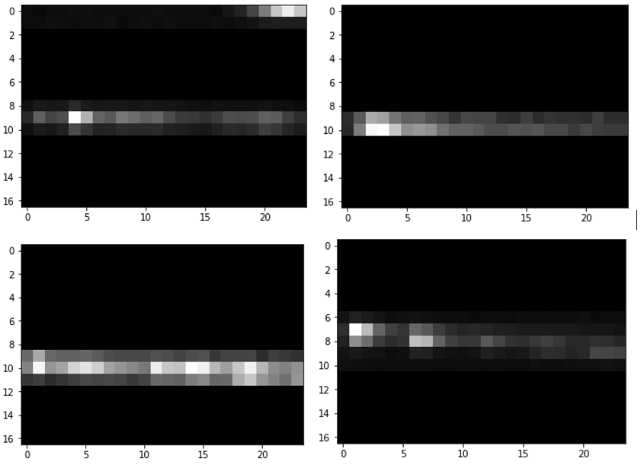

Slide 10
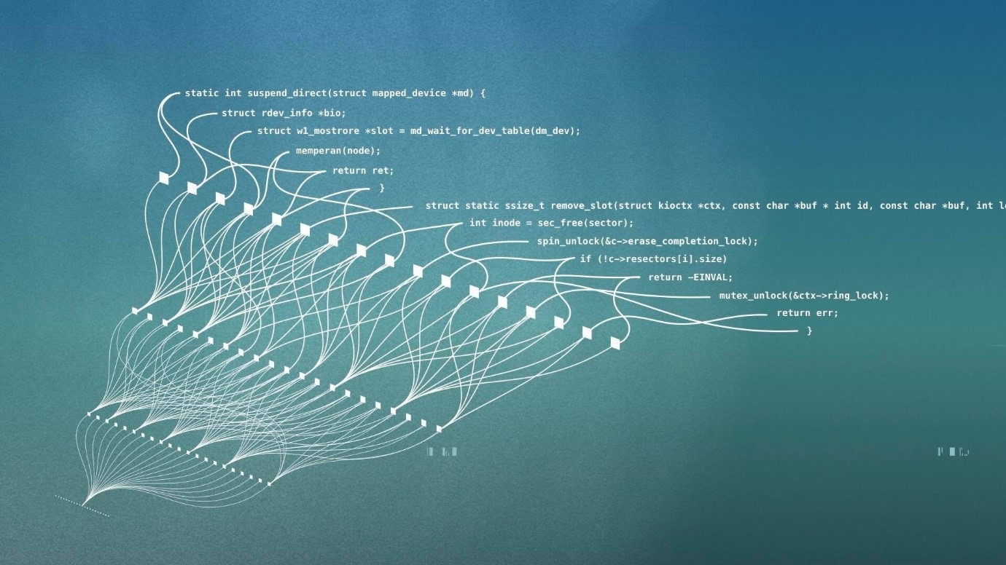
Deep learning

Slide 11


Slide 12

Deep feedforward networks
Nested approximating mapping functions
Maps $x_{i} ; i=\{1,2,…,n\}$ → $y$
$f\left(x_{i,..,n}\right)= f_{a}^{m}(f_{a}^{…}(f_{a}^{2}(f_{a}^{1}(x_{i,…,n}))))$
Each layer takes the form: $w^{T}x+b$
Non-linear activation functions $φ(f_{a}(x))$ captures non-linearities in the multidimensional feature space

Slide 13

Activation functions

Slide 14
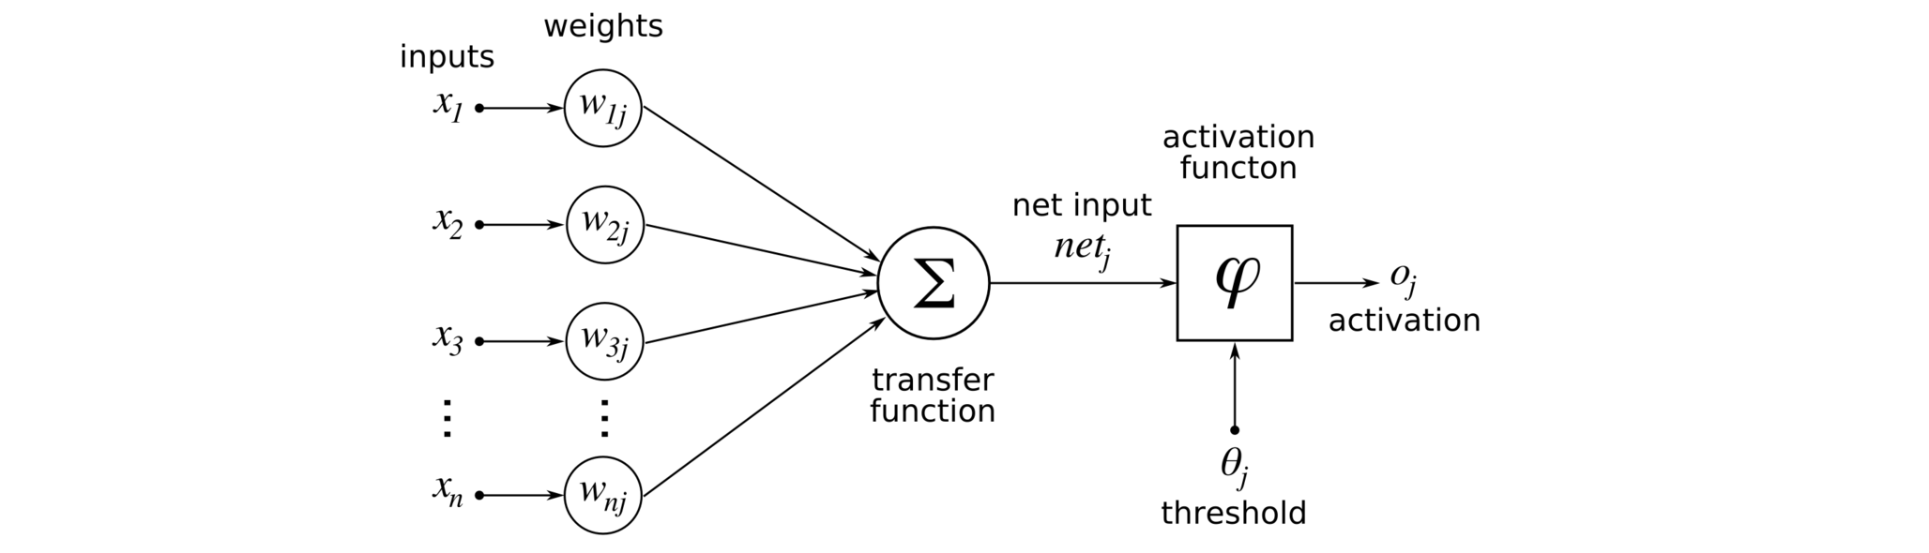

Slide 15
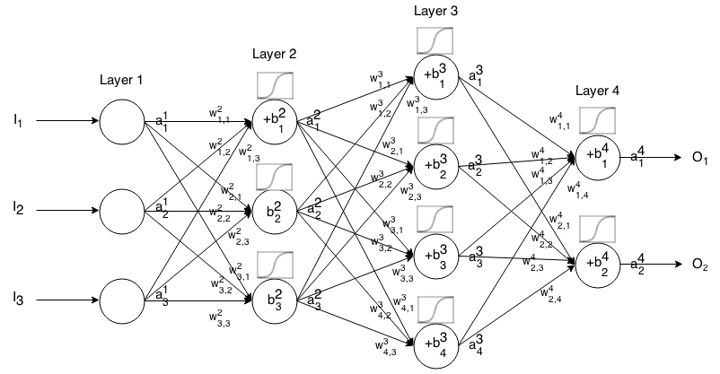
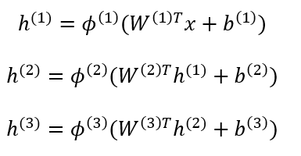

Slide 16
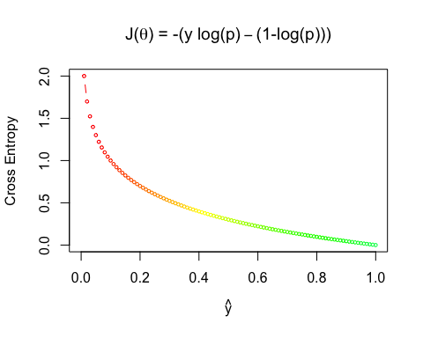

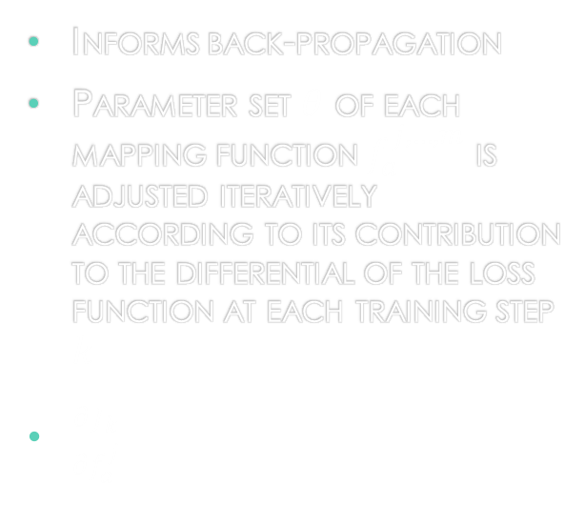
Loss Function
Informs back-propagation
Parameter set $θ$ of each mapping function $f_{a}^{j,…,m}$ is adjusted iteratively according to its contribution to the differential of the loss function at each training step $k$
$\frac{∂J_{k}}{∂f_{a}^{j}}$

Slide 17
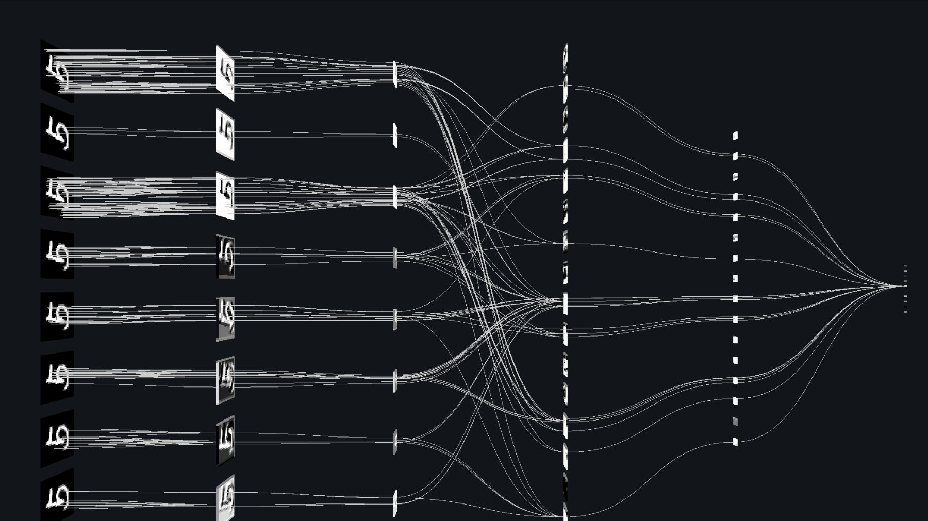
Convolutional Neural networks

Slide 18
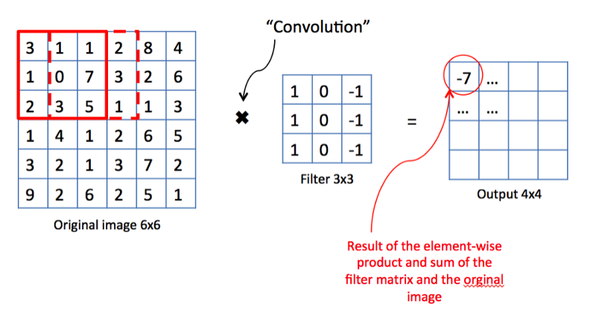
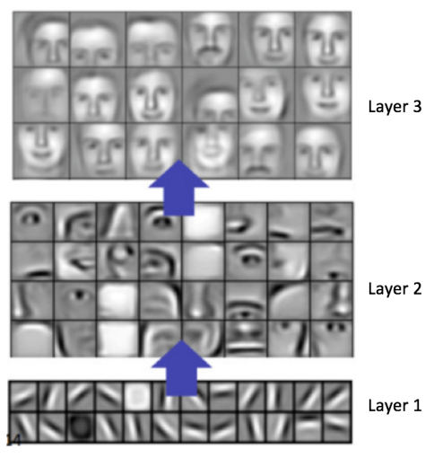
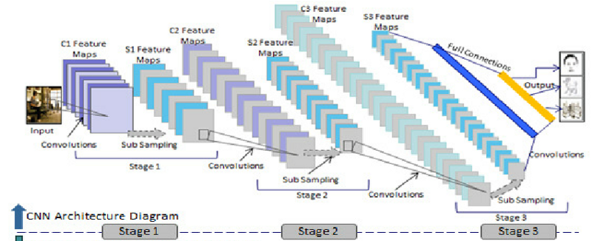
Convolutional Filters

Slide 19
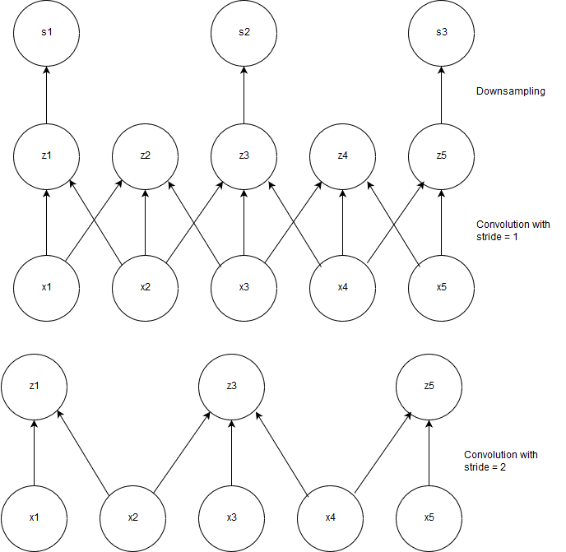

Slide 20
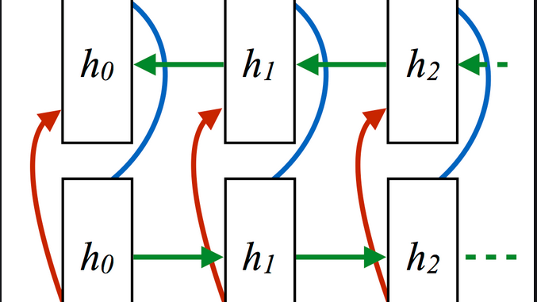
Recurrent neural networks

Slide 21
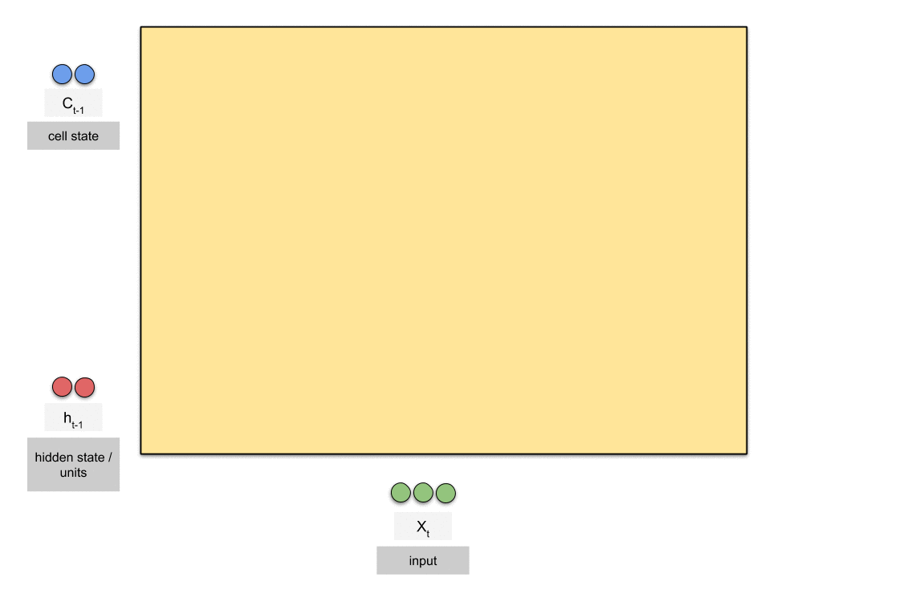
LSTM cell

Slide 22
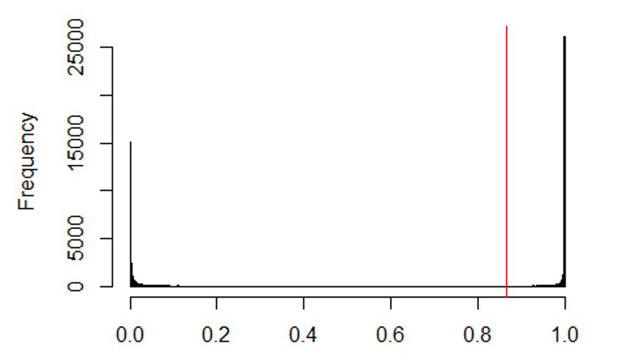
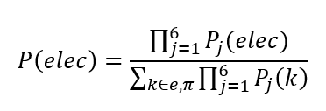
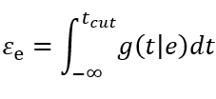

Particle identification results
Pion efficiency $ε_{π}=2.2\%$ at electron efficiency $ε_{e^{−}}=90\%$

Slide 23
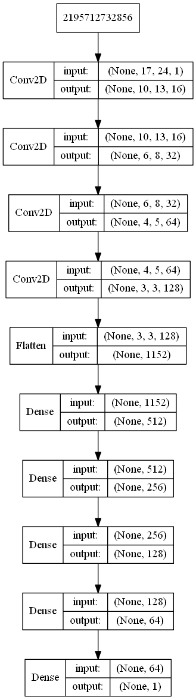
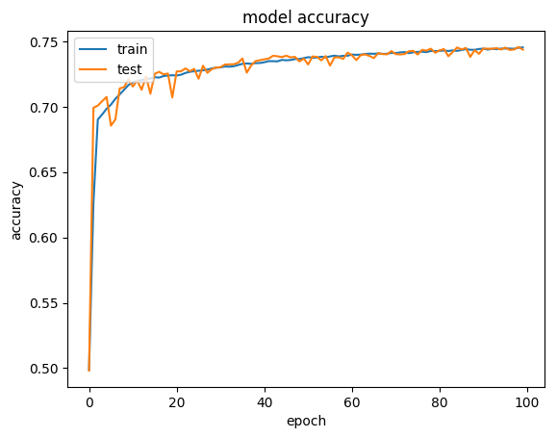
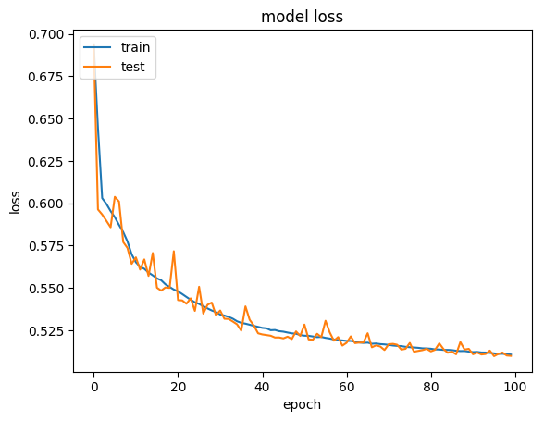
Architecture and training curves

Slide 24
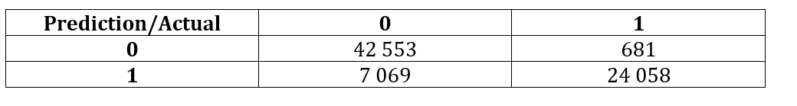
Distinguishing geant from real data results

Slide 25
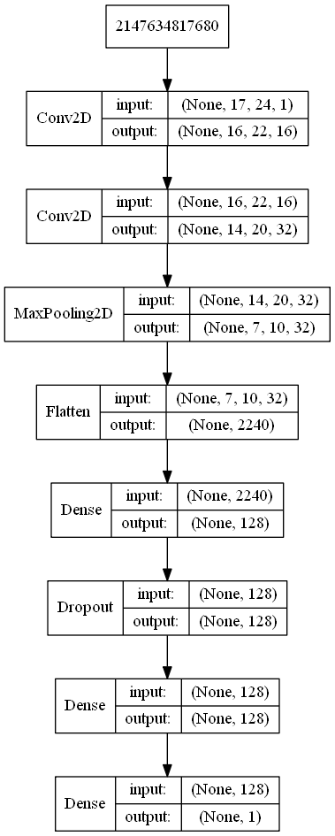
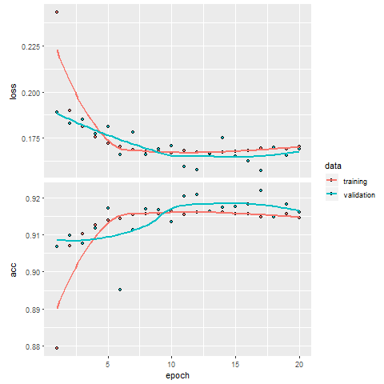
Architecture and training curves

Slide 26
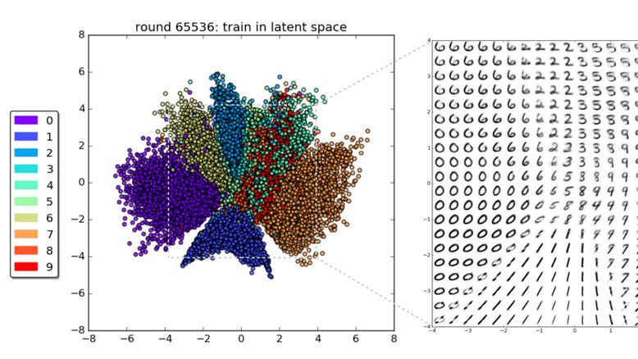
Latent variable models
deep generative modeling

Slide 27
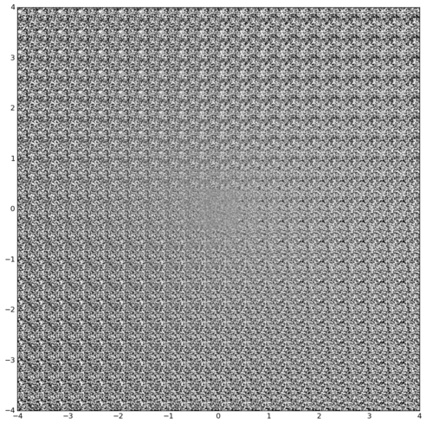
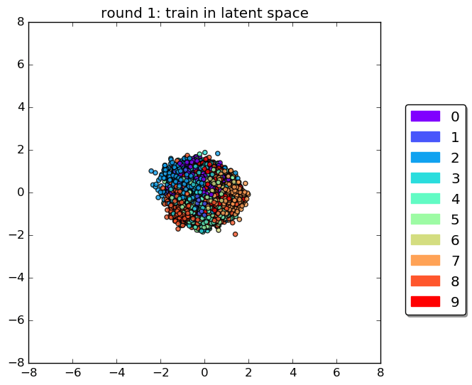

Slide 28
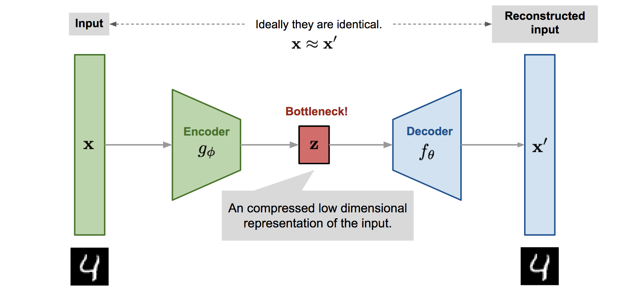
Variational Autoencoders

Slide 29
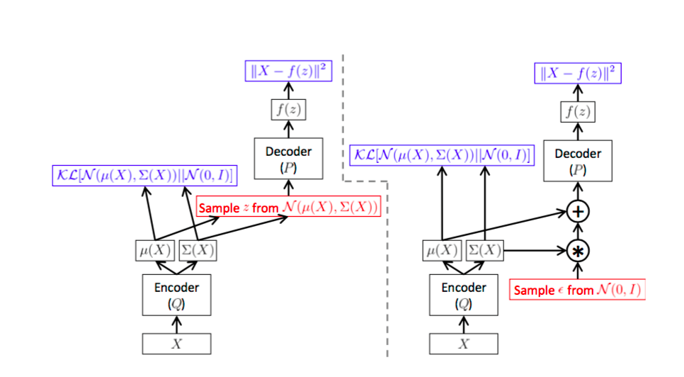

Slide 30
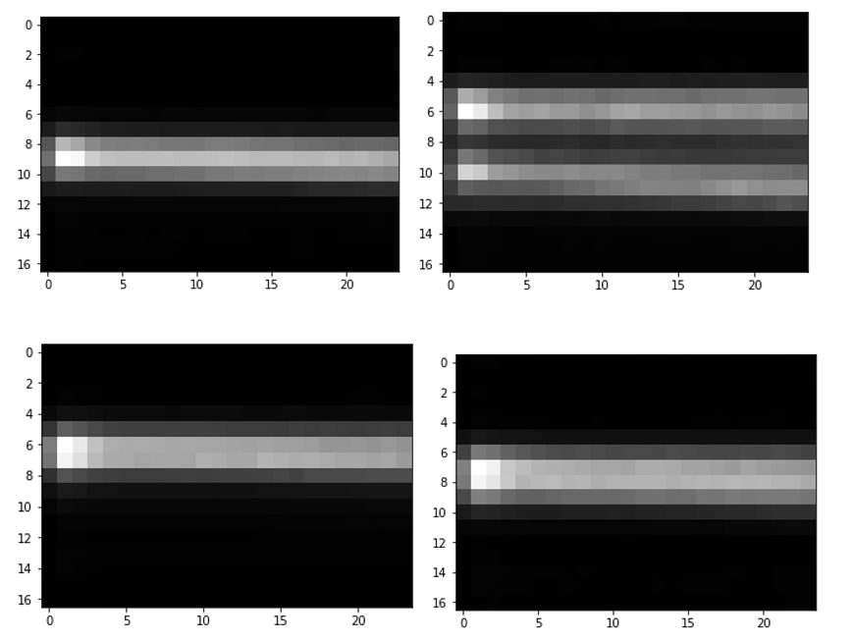
VAE results
Variational Autoencoder
Real Data

Slide 31
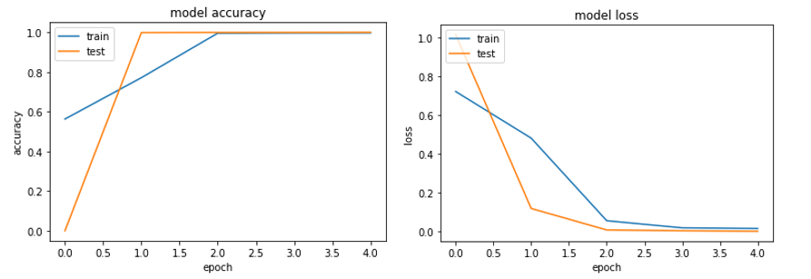
Distinguishing variational autoencoder data from real data

Slide 32
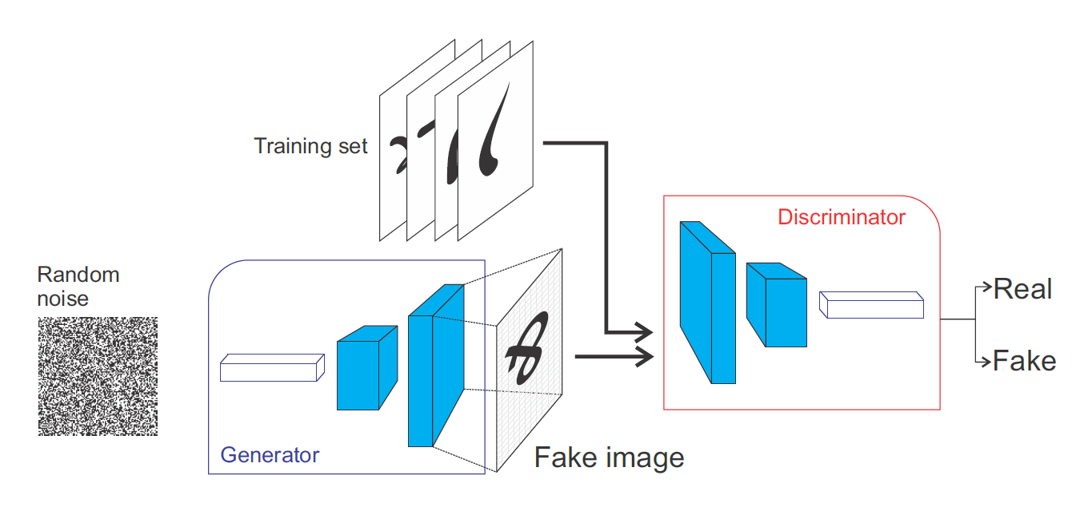
Generative adversarial networks

Slide 33
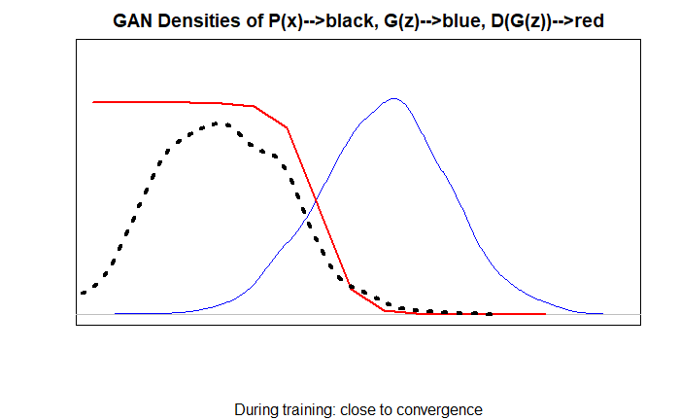
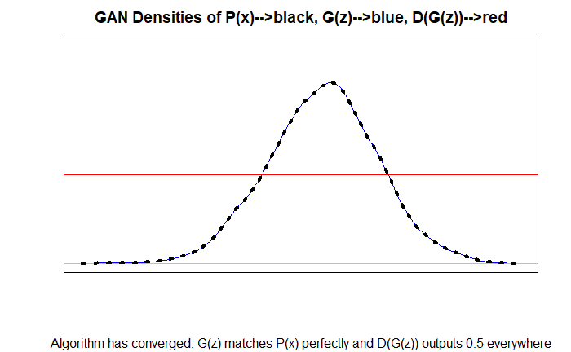
GAN densities during training
Close to convergence
Algorithm has converged

Slide 34
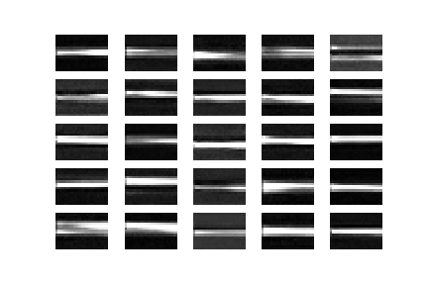
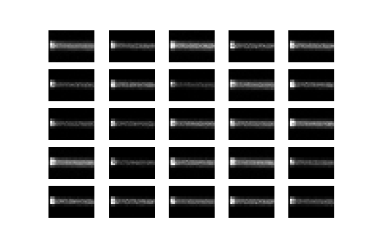
GAN Results
Adversarial autoencoder 1
Adversarial autoencoder 2

Slide 35
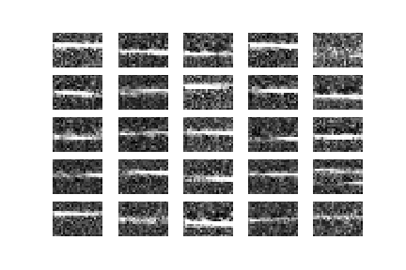
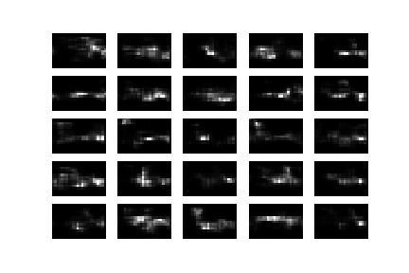
GAN results
Bidirectional GAN
Deep convolutional GAN

Slide 36
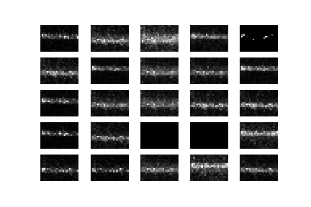
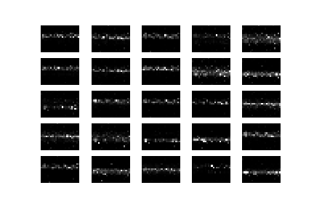
GAN Results
Vanilla GAN
Least Squares GAN

Slide 37
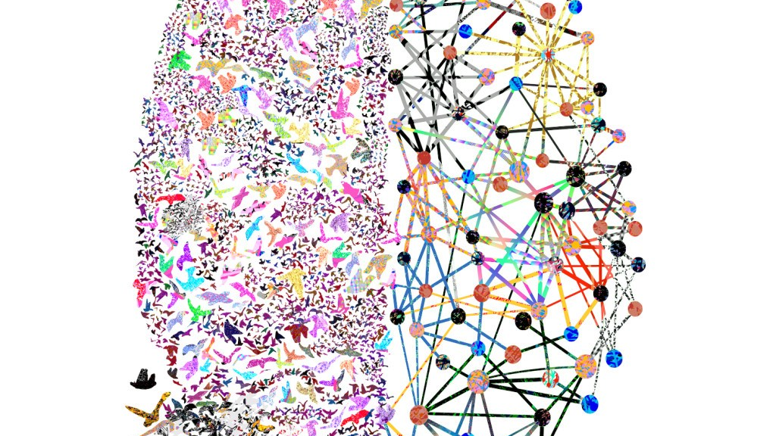
Any questions?

